Slide 1
Taboo Game-like: Project
Intelligent Interfaces
Wissam Nasser, Wouter Parys, Charlotte Waltregny

Slide 2
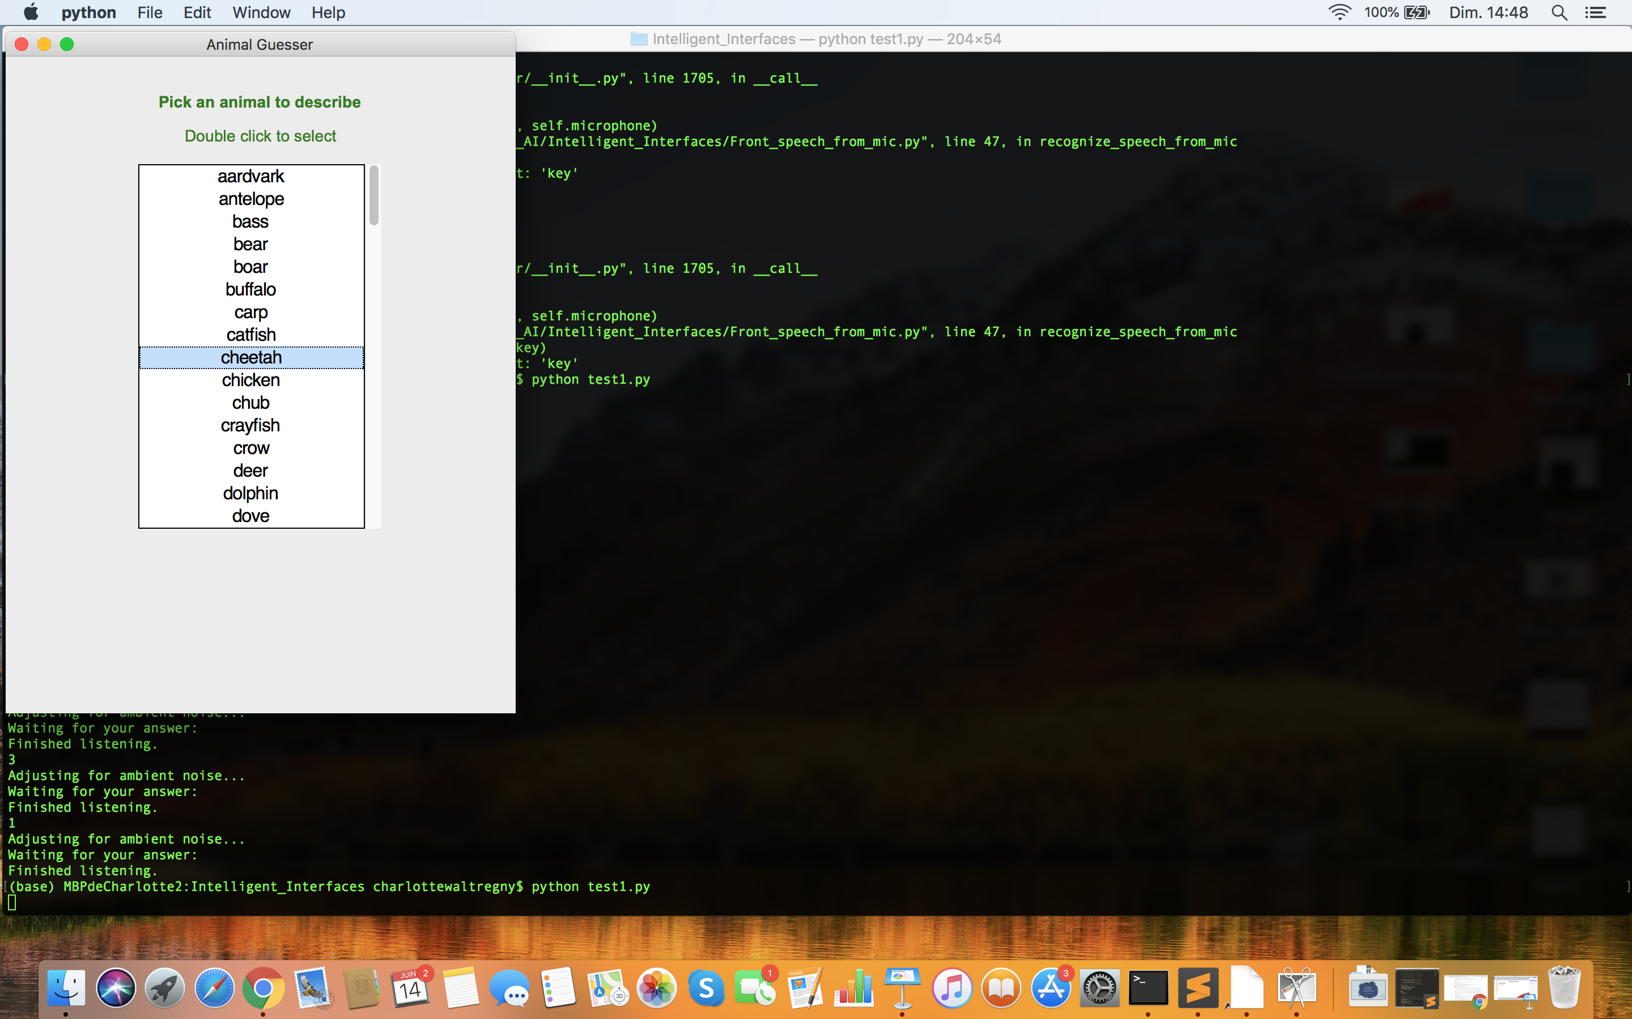
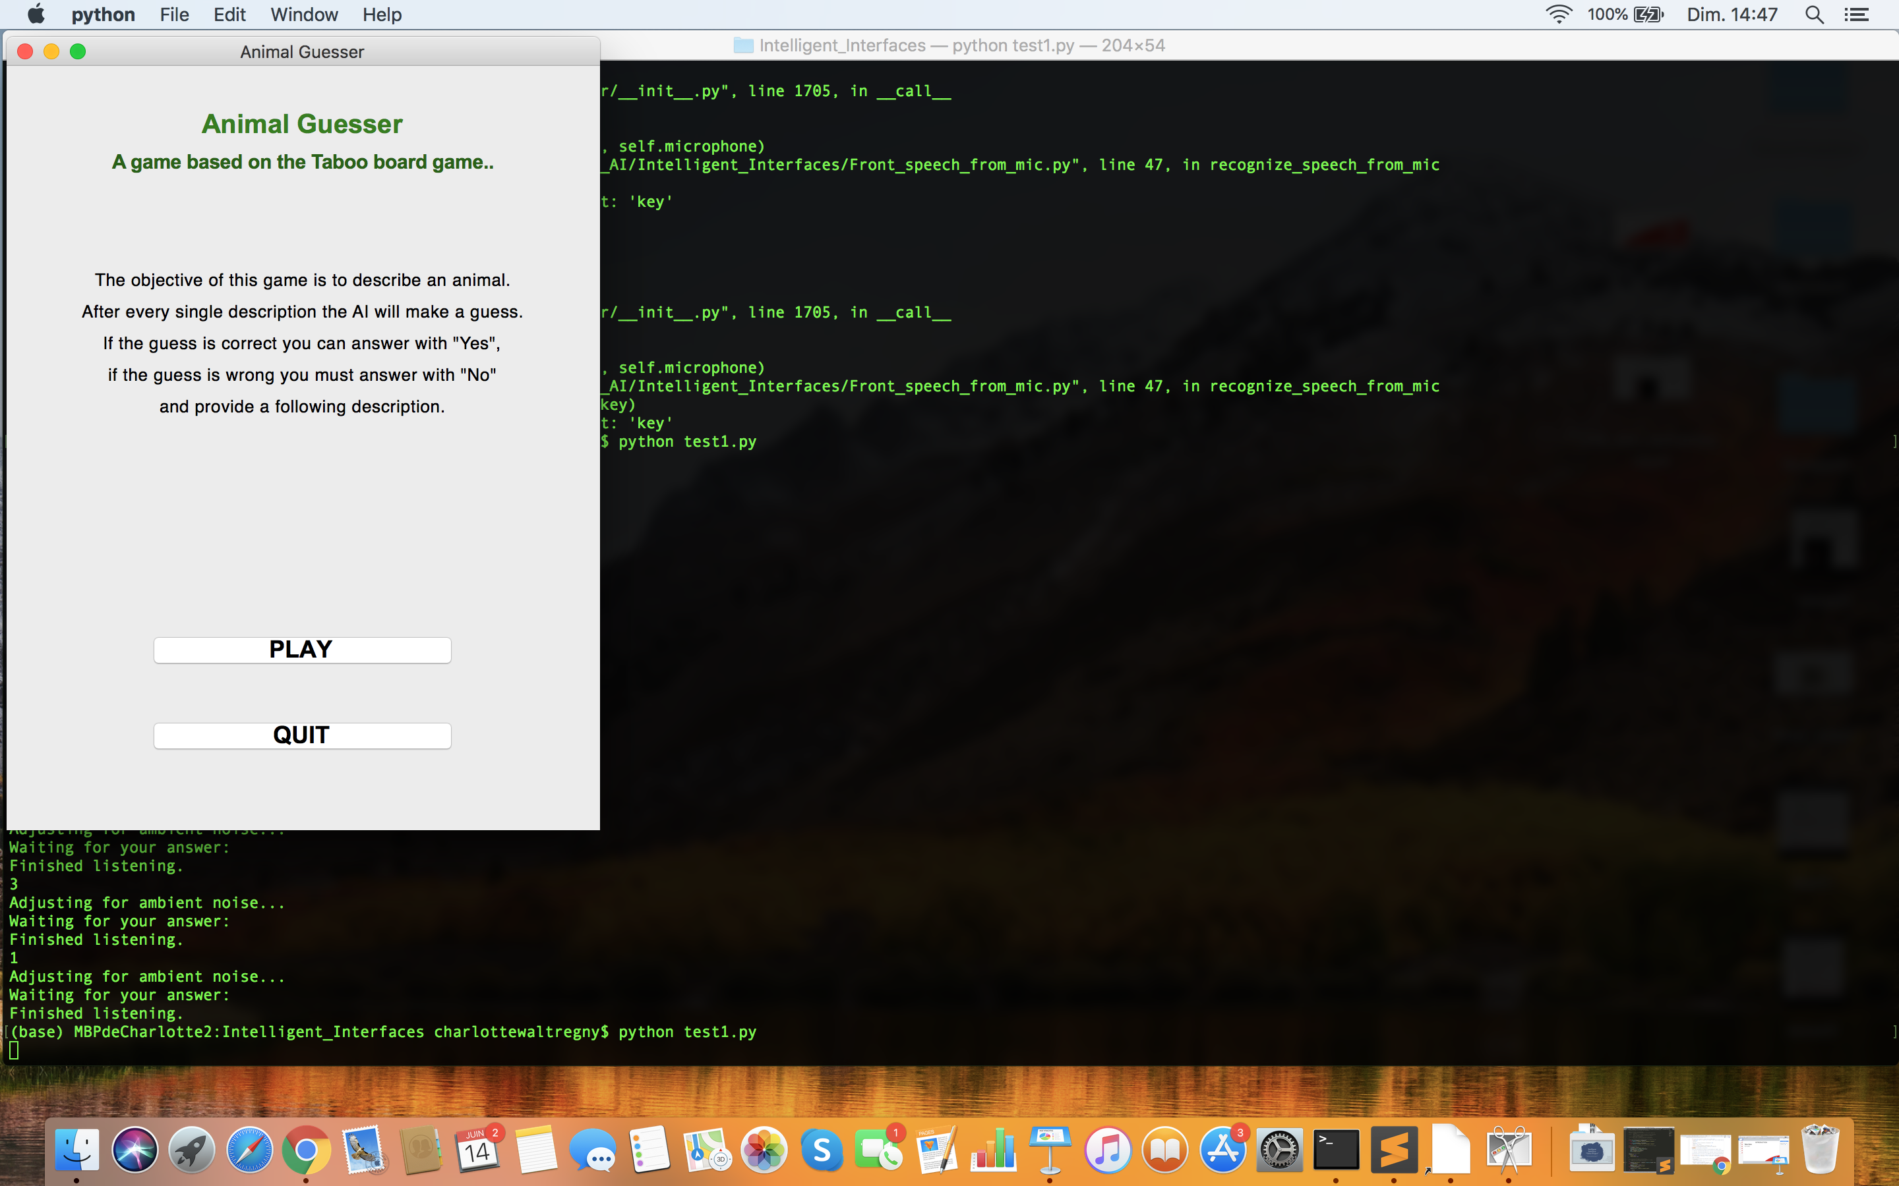
INTRODUCTION
Taboo Game-like
How to play?
1
2
User selects animal
in the dropdown list
retrieved from ElasticSearch
database
User presses PLAY button

Slide 3
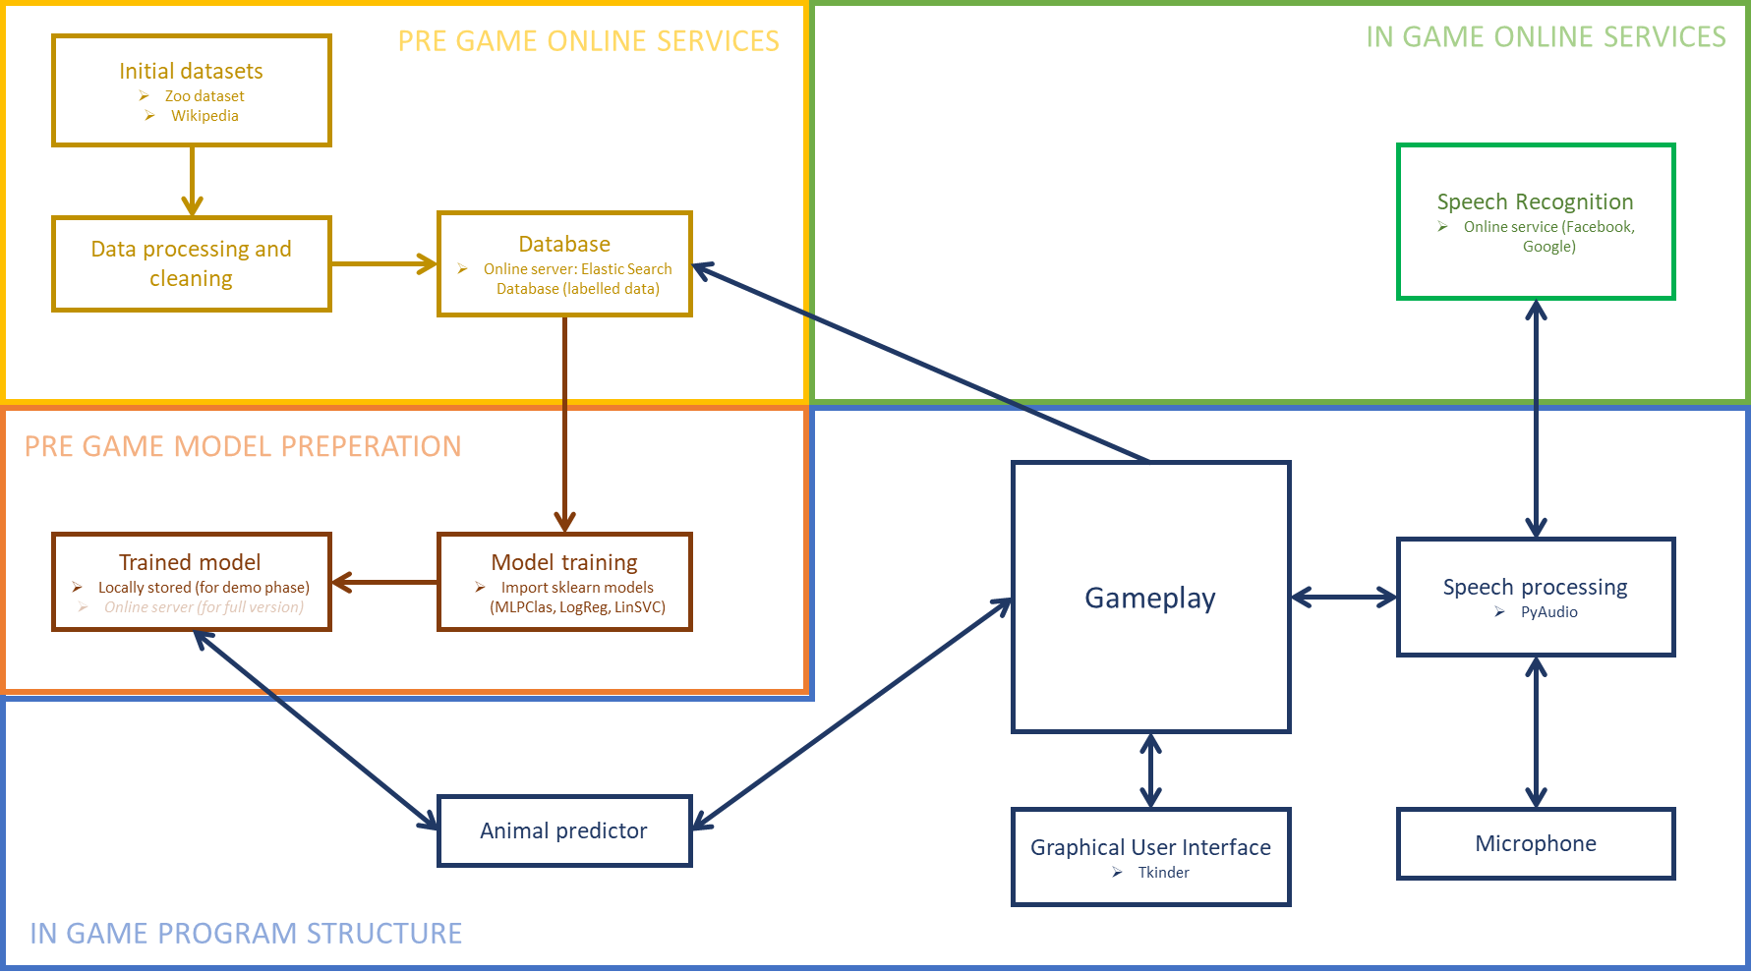
INTRODUCTION
Behind the scenes

Slide 4
DATABASE
ElasticSearch

Slide 5
DATABASE
ElasticSearch

Slide 6
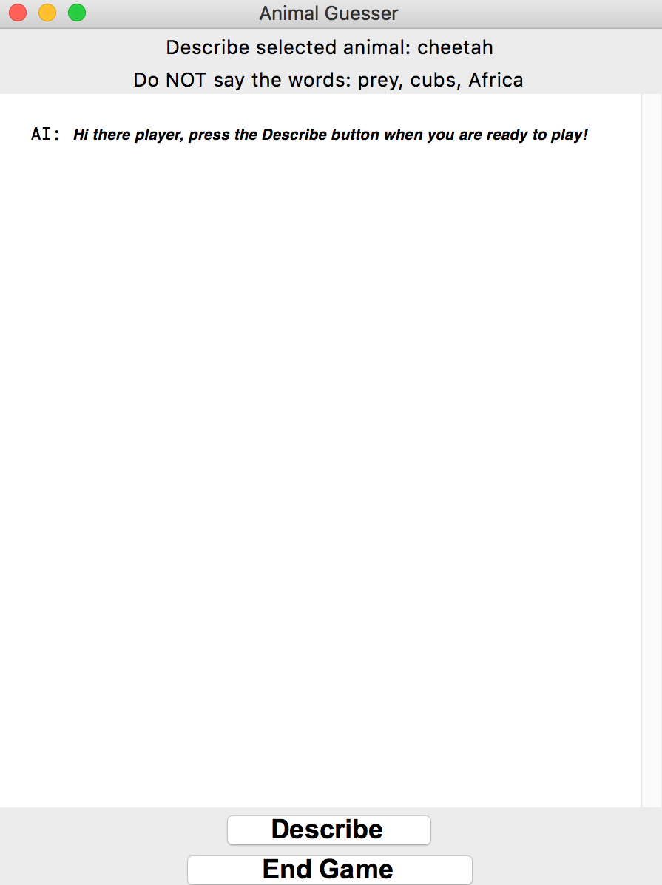
FRONT-END
Taboo Game-like
How to play?
3
User presses the DESCRIBE
button and starts describing
the animal without saying the
Taboo words

Slide 7
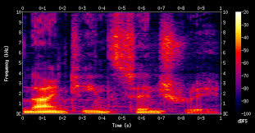
BRAIN ASPECT 1
Speech Recognition
How does it work?
Input spectrogram spoken letter
(audio slice of 20-40ms)
Each letter influences
the likelihood of the next
RNN
Probability of being […]
Z
A
B
C

Slide 8





BRAIN ASPECT 1
Speech Recognition
Speech Recognition as a Service
No account
needed
Audio
streaming
Unlimited
API call
Free

Slide 9
BRAIN ASPECT 1
Speech Recognition
Using SpeechRecognition and PyAudio python libraries
Retrieve
raw data
Convert to
.WAV
Retrieve speech
to text
User speaks
SaaS API
PyAudio
SpeechRecognition
SpeechRecognition
WIT API

Slide 10
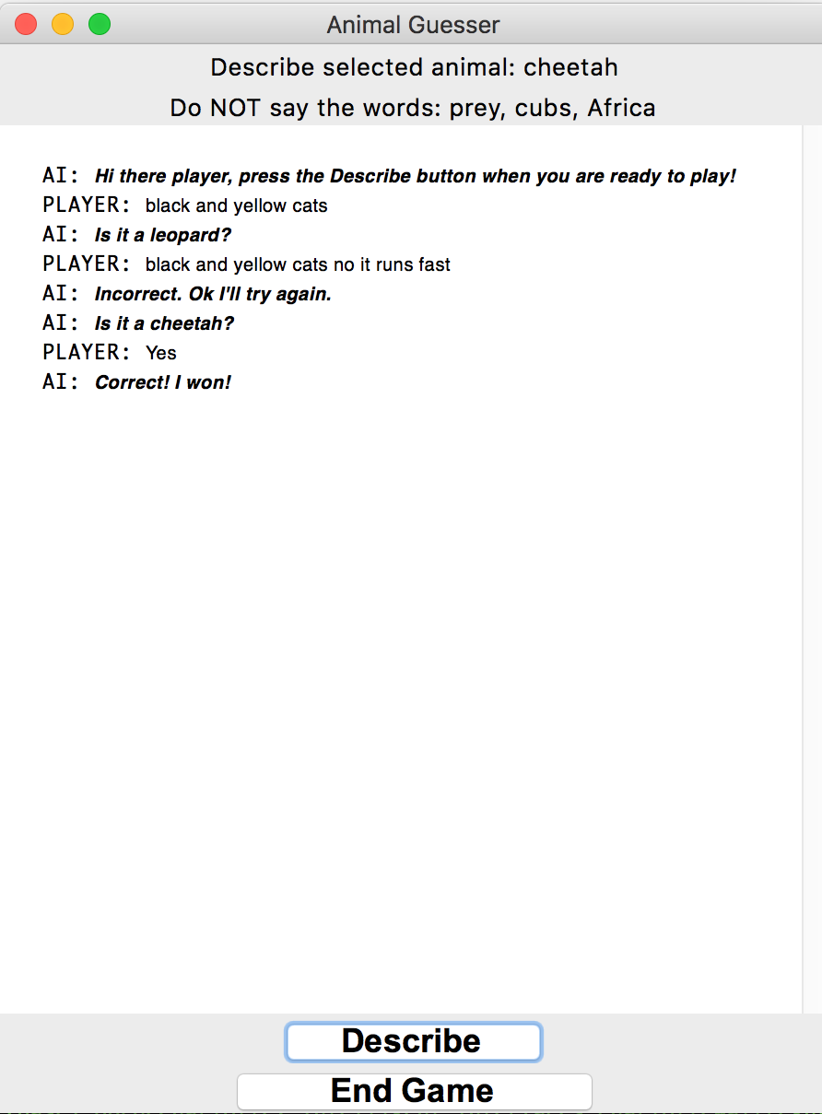
FRONT-END
Taboo Game-like
How to play?
4
The text is displayed
on the Chatbox and NLP
can be used to guess
the animal

Slide 11
BRAIN ASPECT 2
Natural Language Processing
GOAL: Lightweight, accurate and fast program/app to play the taboo game
→ three potential strategies detected
*When words of new datapoint already exists in dataset (no new vector transformation needed)

Slide 12



BRAIN ASPECT 2
Natural Language Processing
Strategy 1: Convert text file for each animal to vector (bag of words, sklearn.countVectorizor, sklearn.tfidfVectorizer) and compare spoken text from player with labeled data (cossine similarity)
Uses a transformation to change input text to compare with dataset. Adds (limited) complexity.
Need to have access to full dataset (or vector) for each animal in the game
When new words are added to the dataset, the transformation has to be recalculated and all the animal vectors have to be updated. limited dynamics of the game
If access to dataset, no training needed, very quick and robust calculation

Slide 13



BRAIN ASPECT 2
Natural Language Processing
Strategy 2: query string data for each animal on an online accessible server with built in similarity calculations and fast look ups (Elastic Search database adopted for the purpose of this project)
No need for a transformation of any kind. New data can be directly stored in string format in the database
If the database is not loaded locally, online accesibility has to be reassured to play the game
When online access possible, very quick and efficiënt results on similarity
High dynanmics of the game. If one player loads new description data onto the Elastic search database, other players will be able to directly access this new information
More black box to use, difficult to personalise searching algorithms for the specific dynamics of the taboo game

Slide 14
BRAIN ASPECT 2
Natural Language Processing
Strategy 3: training a neural network on an online dataset (Elastic Search in the case of this project). The neural network can be accessed locally or online
Uses a transformation to change input text to compare with dataset. Adds (limited) complexity.
A trained classifier model is limited in size and can be locally stored and accessed. The game can be played offline.
Easy to create new samples from data gathered by playing the game.
With new labeled examples added to the dataset, the model has to be retrained to include all of these new information.
A Neural Network based model should be able to cope with more natural language nuances than a simple similarity comparison.

Slide 15
BRAIN ASPECT 2
Natural Language Processing
Results

Slide 16
BRAIN ASPECT 2
Natural Language Processing
GOAL: Lightweight and fast program/app to play the taboo game
→ three potential strategies detected
 | Offline possible? | Adding new info | Dynamic updating | Data transformation
Strategy 1: Vector similarity on full string dataset | Yes (when all data available) | Restructure existing data | Low | Yes
Elastic Search querying (full online platform) | No (unless all data stored locally) | Restructure existing data | High | No
Trained classifier model on labeled data | Yes (when trained model available) | Easy (add new labeled data) | Medium* | Yes
*When words of new datapoint already exists in dataset (no new vector transformation needed)

Slide 17
FRONT-END
Taboo Game-like
How to play?
7
6
5
The game goes on until
the agent makes the correct
guess (the player says
yes), if 30s has passed or
if player says a taboo word
If agent is wrong, player
provides more info and
we go back to step 3
Agent makes its first guess

Slide 18
CHALLENGES
Issues faced

Slide 19
POSSIBLE IMPROVEMENTS

Slide 20
CONCLUSION

